Slide 1

Cloud Computing
Topic: Hadoop, Map Reduce & Virtual Box

Slide 2
Contents
Hadoop
- Map Reduce
Virtual Box

Slide 3
Hadoop
Hadoop is an open-source software framework for storing data and running applications on clusters of commodity hardware.
It provides massive storage for any kind of data, enormous processing power and the ability to handle virtually limitless concurrent tasks or jobs.
Today, Hadoop’s framework and ecosystem of technologies are managed and maintained by the non-profit Apache Software Foundation (ASF), a global community of software developers and contributors.

Slide 4
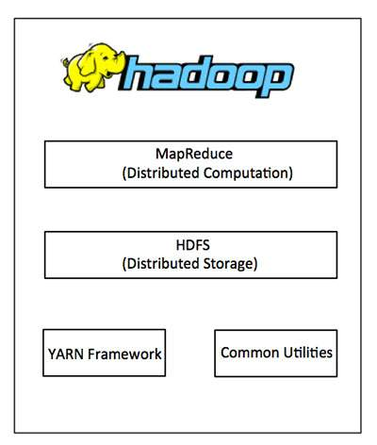
Hadoop Architecture
At its core, Hadoop has two major layers namely −
- Processing/Computation layer (MapReduce), and
- Storage layer (Hadoop Distributed File System)

Slide 5
Modules of Hadoop
Hadoop Distributed File-System(HDFS)
A Hadoop system uses its own file system which sits "above" the file system of the host computer - meaning it can be accessed using any computer running any supported OS.
It allows data to be stored in an easily accessible format, across a large number of linked storage devices.
It is highly fault-tolerant and is designed to be deployed on low-cost hardware.
It provides high throughput access to application data and is suitable for applications having large datasets.

Slide 6
2. MapReduce
MapReduce is named after the two basic operations this module carries out-
reading data from the database,
putting it into a format suitable for analysis (map),
and performing mathematical operations i.e counting the number of males aged 30+ in a customer database (reduce).

Slide 7
3. Hadoop Common
The other module is Hadoop Common, which provides the tools (in Java) needed for the user's computer systems (Windows, Unix or whatever) to read data stored under the Hadoop file system.
4. YARN
The final module is YARN, which manages resources of the systems storing the data and running the analysis.
Various other procedures, libraries or features have come to be considered part of the Hadoop "framework" over recent years, but Hadoop Distributed File System, Hadoop MapReduce, Hadoop Common and Hadoop YARN are the principle four.

Slide 8
How Does Hadoop Work?
It is quite expensive to build bigger servers with heavy configurations that handle large scale processing, but as an alternative, you can tie together many commodity computers with single-CPU, as a single functional distributed system and practically, the clustered machines can read the dataset in parallel and provide a much higher throughput.
Moreover, it is cheaper than one high-end server. So this is the first motivational factor behind using Hadoop that it runs across clustered and low-cost machines.

Slide 9
The Usage of Hadoop
The flexible nature of a Hadoop system means companies can add to or modify their data system as their needs change, using cheap and readily-available parts from any IT vendor.
Today, it is the most widely used system for providing data storage and processing across "commodity" hardware - relatively inexpensive, off-the-shelf systems linked together, as opposed to expensive, bespoke systems custom-made for the job in hand.
The support and enthusiasm of the open source community behind it has led to great strides towards making big data analysis more accessible for everyone.

Slide 10
Hadoop - Map Reduce
MapReduce is a processing technique and a program model for distributed computing based on java.
The MapReduce algorithm contains two important tasks, namely Map and Reduce.
Map takes a set of data and converts it into another set of data, where individual elements are broken down into tuples (key/value pairs).
Secondly, reduce task, which takes the output from a map as an input and combines those data tuples into a smaller set of tuples.

Slide 11
The Algorithm
Generally MapReduce paradigm is based on sending the computer to where the data resides.
MapReduce program executes in three stages, namely map stage, shuffle stage, and reduce stage.
Map stage − The map or mapper’s job is to process the input data. Generally the input data is in the form of file or directory and is stored in the Hadoop file system (HDFS).
Reduce stage − This stage is the combination of the Shuffle stage and the Reduce stage. The Reducer’s job is to process the data that comes from the mapper.

Slide 12
The Algorithm
During a MapReduce job, Hadoop sends the Map and Reduce tasks to the appropriate servers in the cluster.
The framework manages all the details of data-passing.
Most of the computing takes place on nodes with data on local disks that reduces the network traffic.
After completion of the given tasks, the cluster collects and reduces the data to form an appropriate result, and sends it back to the Hadoop server.

Slide 13
Virtual Box
VirtualBox is a GUI and command line tool that makes it possible to deploy servers, desktops, and embedded operating systems as VMs.
A single VirtualBox host can deploy as many guest VMs as the host hardware can handle.
The host houses the VirtualBox software that can then deploy the guests. A guest is any supported operating system running as a VM.
A VirtualBox host can be run on Linux, Windows, or macOS, whereas a VirtualBox guest can consist of any Linux distribution, Solaris, macOS, BSD, IBM OS/2, or Windows.
In order to run macOS or Windows as a VM, you must have a licensed copy of the operating system in question.

Slide 14
The host can run as many guests as the hardware will support, while still leaving enough resources for the host to operate. Each individual guest can be started, stopped, and paused from either the GUI or the command line and can function on a network as if it were running on its own hardware.
VirtualBox can be run from either a user-friendly GUI or from the command line. Thanks to the command line option, VMs can be deployed on a server with or without a GUI, making the software highly flexible.

Slide 15
References
https://www.virtualbox.org/wiki/VirtualBox
https://en.wikipedia.org/wiki/VirtualBox
https://www.edureka.co/blog/what-is-hadoop/
https://www.tutorialspoint.com/hadoop/index.htm

Slide 16
Thank You

